Slide 1
Data Analysis of The Red Records.
Ida. B. Wells
Our Team – (Group 4)
Ololade Adetula
Samir Ansari
Ehram Haque
Rohan Ray Yadav
Sabhya Rai
Folusho Adeyemi
Oluwatamilore Oladejo

Slide 2
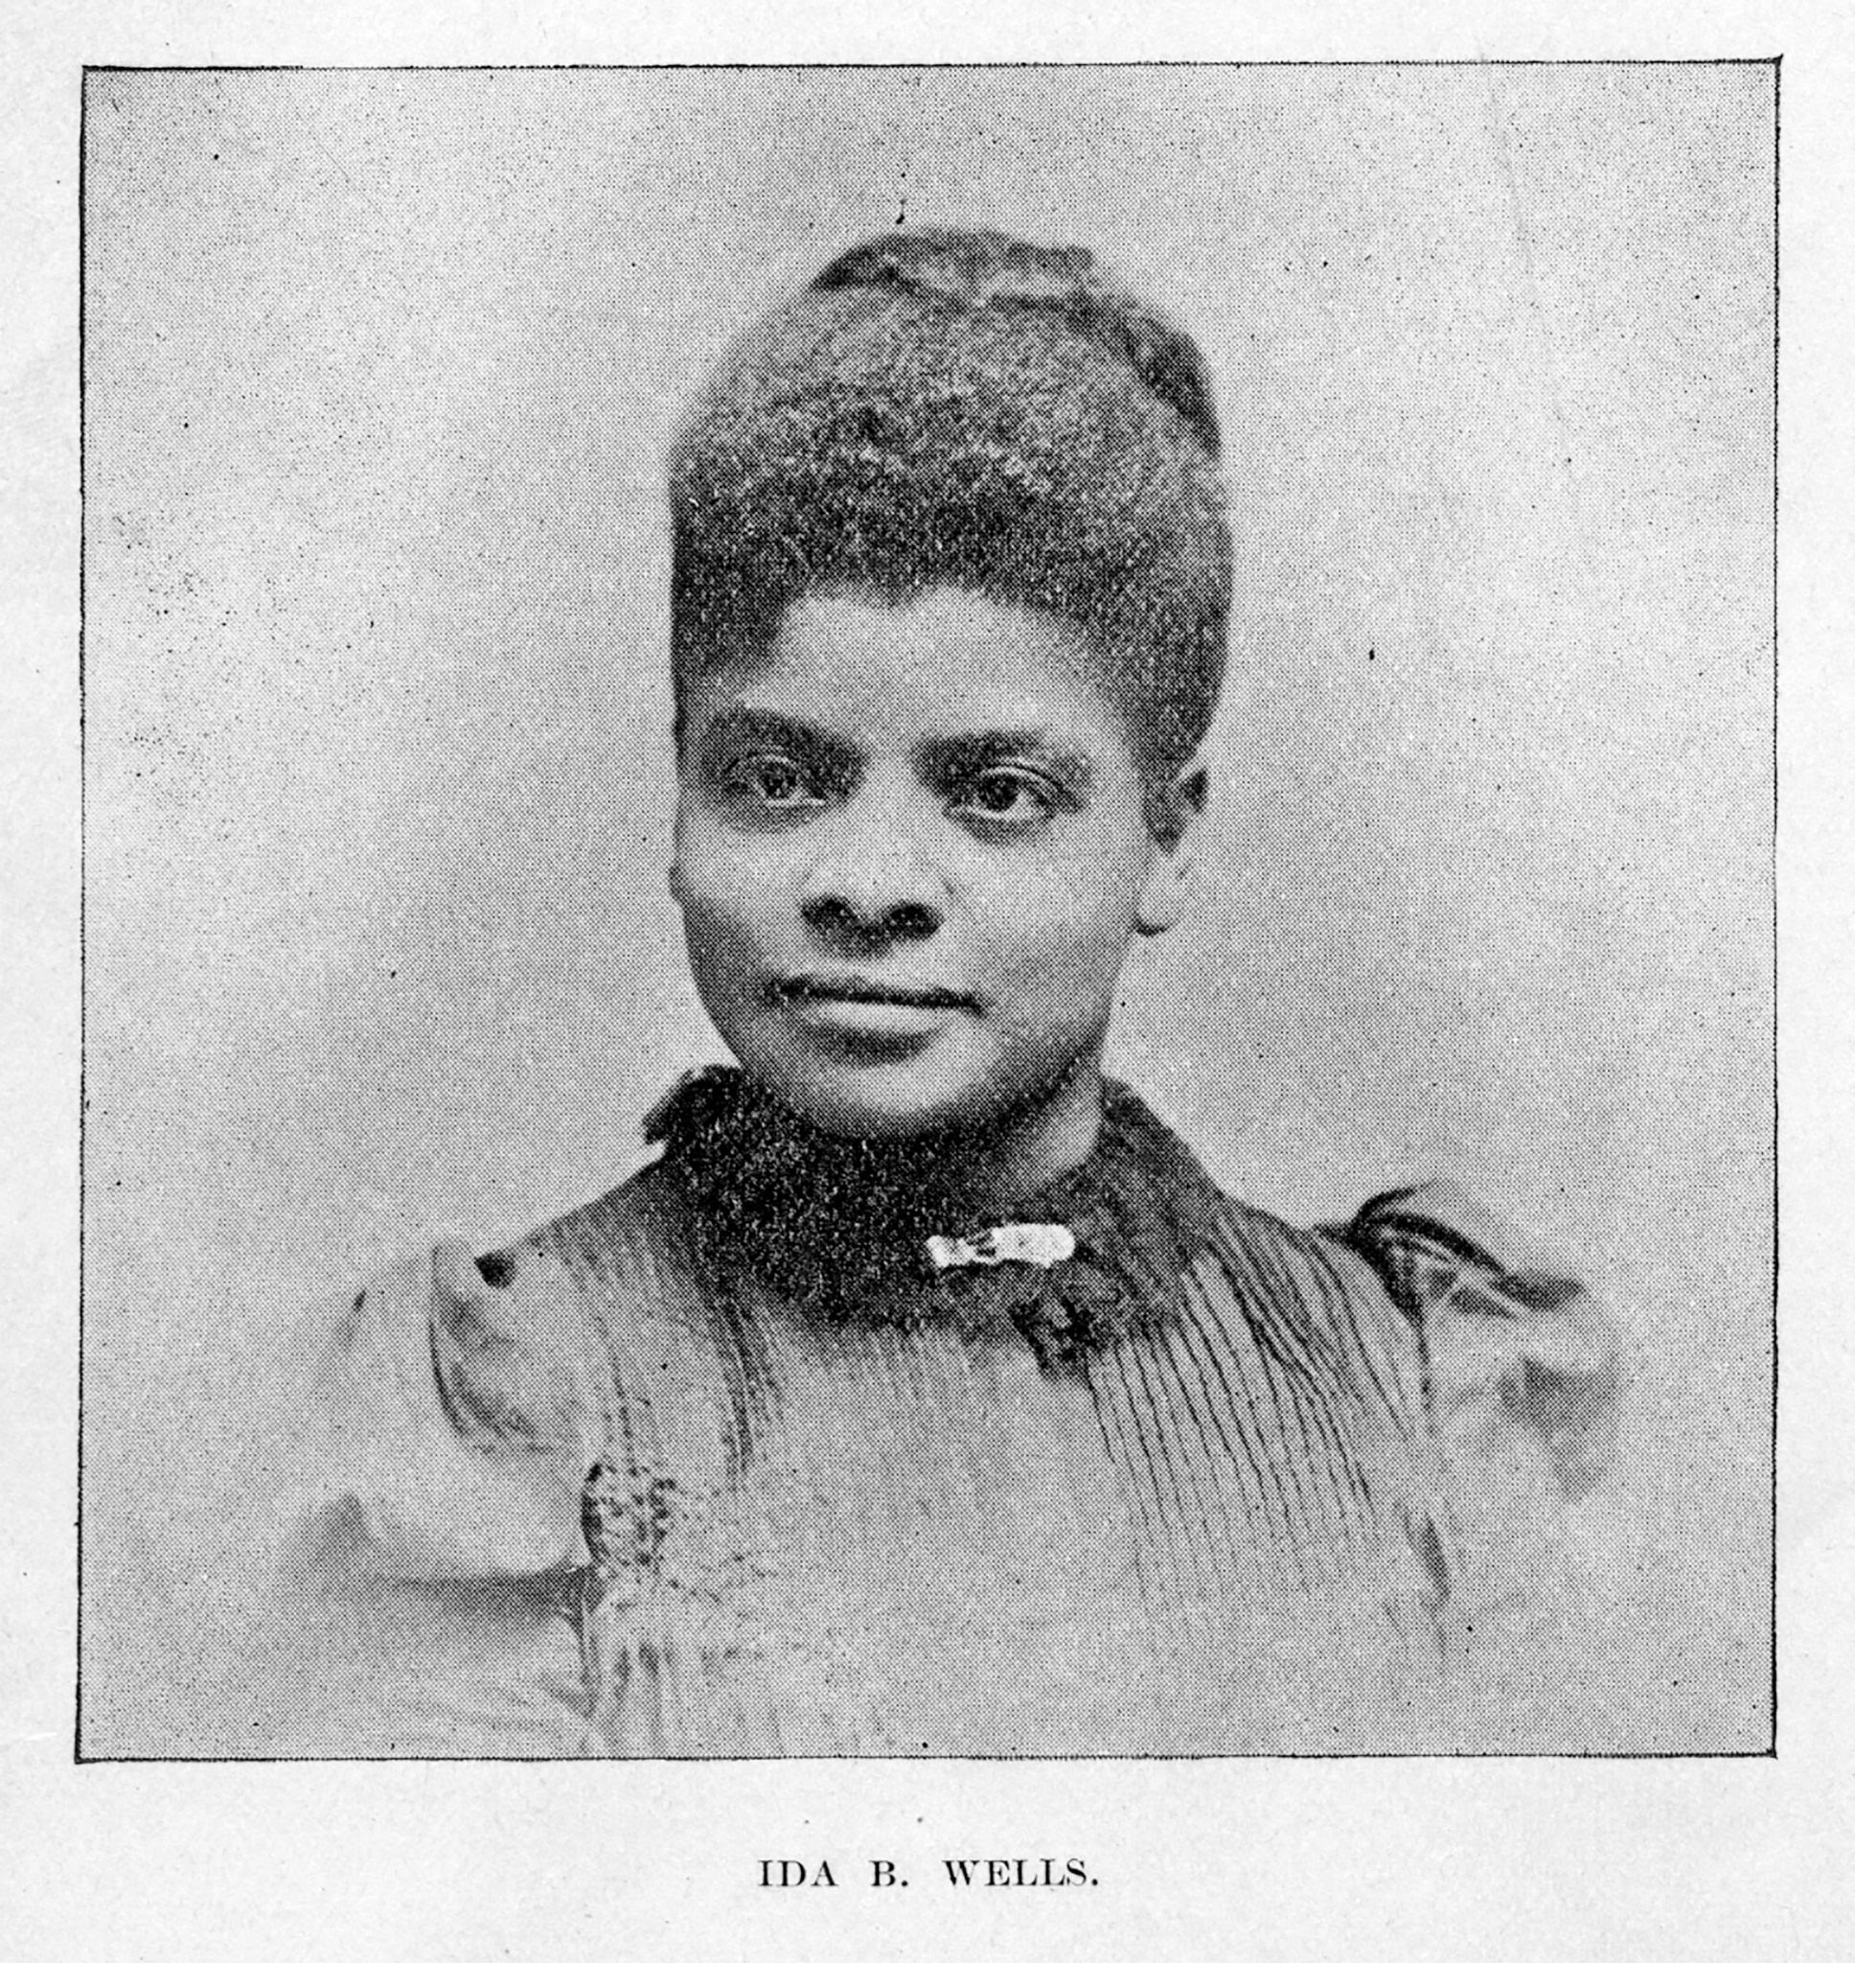


Who was Ida. B. Wells
She was a prominent journalist, activist, and researcher.
Was born in Mississippi in 1862 during the CIvil War.
Led an anti-lynching crusade in the US in the 1890s.
She also fought for women's suffrage.
Published a pamphlet, “Southern Horrors: Lynch Law in All Its Phases,” and a book, A red Record.
It was well who ultimately helped end the violence of lynching against black men and women acter the Civil War.

Slide 3
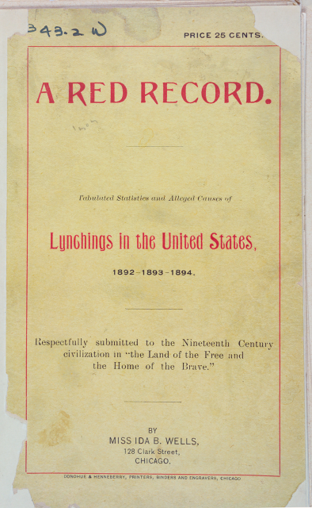
The Red Records by Ida. B. Wells
The Red Record is a slice in time of the terrible history of lynching in the United States, focused on the year 1894.
A Red Record used mainstream white newspapers to document a resurgence of white mob violence, finding that more than 10,000 African Americans had been killed by lynching in the South between 1892 and 1895.

Slide 4
How she collected the lynching data
She researched the names of lynching victims using articles written by white correspondents and press bureaus.
She also conducted interviews with people who had witnessed or been affected by lynchings and gathered testimony from survivors of attempted lynchings.
These stats included the names, date of execution and charges that resulted in lynching.
She begins to categorize the lynchings that took place in 1893 categorizing them by the charges committed. As you look at each section, the date of the lynching as well as the name and location of the victim is listed.
The section goes on to have 28 categories of charges with 159 lynchings in total.

Slide 5
Analysis of The Red Record.
Used python to extract all the useful lynching data from The Red Record.
Categorized the data under meaningful sections to make it more understandable and easy to visualize by importing it into excel sheet.
Created pivot table to quickly summarize the large amounts of data to provide us with more detailed analysis of the numerical data

Slide 6
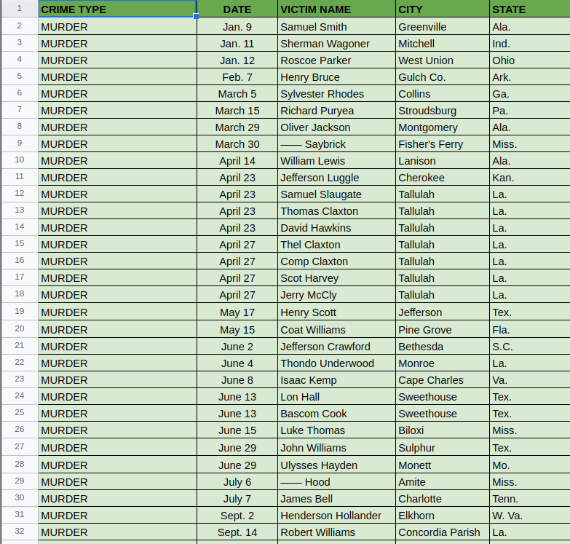
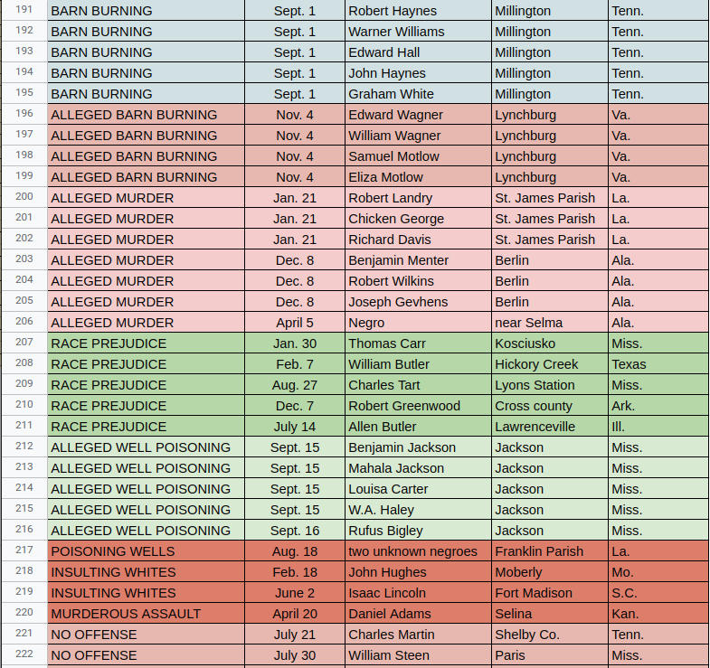
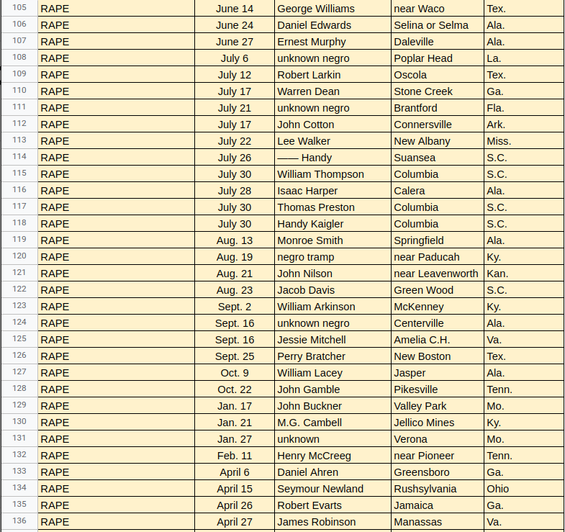

Slide 7
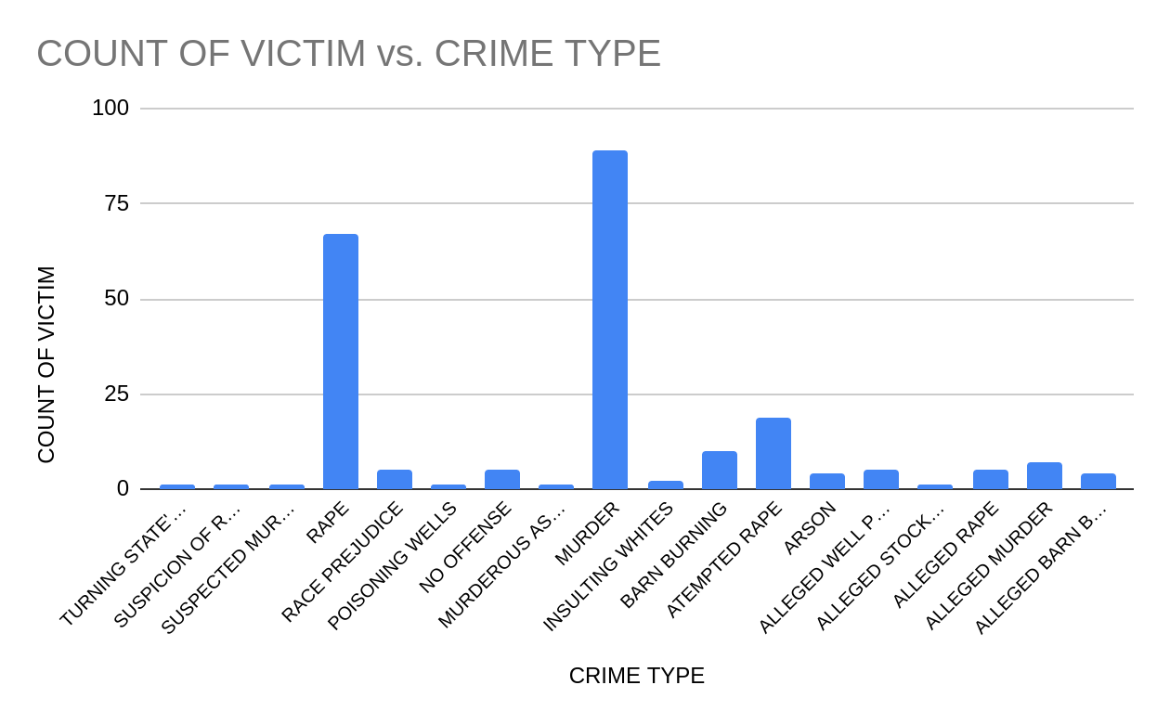
CRIME TYPE | COUNT OF VICTIM
ALLEGED BARN BURNING | 4
ALLEGED MURDER | 7
ALLEGED RAPE | 5
ALLEGED STOCK POISONING | 1
ALLEGED WELL POISONING | 5
ARSON | 4
ATEMPTED RAPE | 19
BARN BURNING | 10
INSULTING WHITES | 2
MURDER | 89
MURDEROUS ASSAULT | 1
NO OFFENSE | 5
POISONING WELLS | 1
RACE PREJUDICE | 5
RAPE | 67
SUSPECTED MURDER | 1
SUSPICION OF RAPE | 1
TURNING STATE'S EVIDENCE | 1
Grand Total | 228

Slide 8
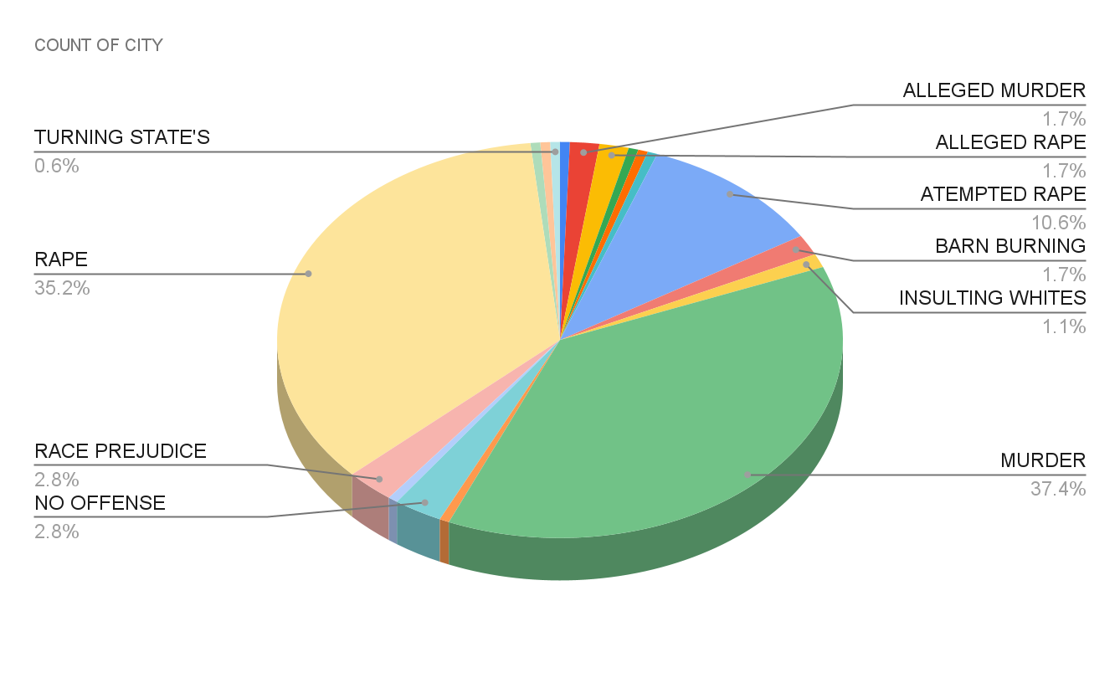
CRIME TYPE | COUNT OF CITY
ALLEGED BARN BURNING | 1
ALLEGED MURDER | 3
ALLEGED RAPE | 3
ALLEGED STOCK POISONING | 1
ALLEGED WELL POISONING | 1
ARSON | 1
ATEMPTED RAPE | 19
BARN BURNING | 3
INSULTING WHITES | 2
MURDER | 67
MURDEROUS ASSAULT | 1
NO OFFENSE | 5
POISONING WELLS | 1
RACE PREJUDICE | 5
RAPE | 63
SUSPECTED MURDER | 1
SUSPICION OF RAPE | 1
TURNING STATE'S EVIDENCE | 1
Grand Total | 174

Slide 9
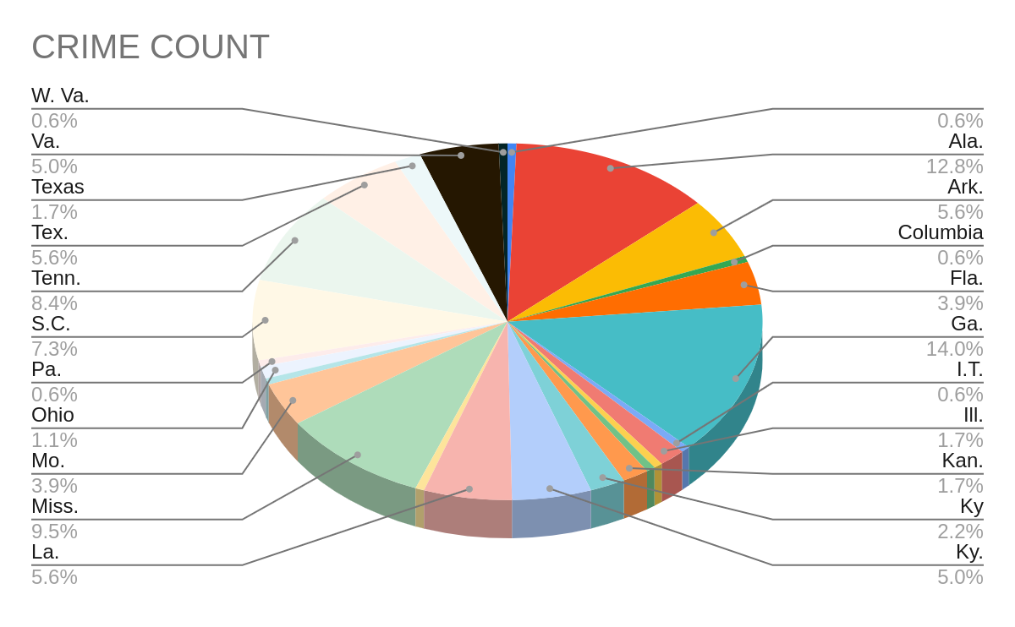
STATE | NO OF CITIES WITH CRIME
Ala. | 23
Ark. | 10
Columbia | 1
Fla. | 7
Ga. | 25
I.T. | 1
Ill. | 3
Ind. | 1
Jellico | 1
Kan. | 3
Ky | 4
Ky. | 9
La. | 10
Md. | 1
Miss. | 17
Mo. | 7
N.Y. | 1
Ohio | 2
Pa. | 1
S.C. | 13
Tenn. | 15
Tex. | 10
Texas | 3
Va. | 9
W. Va. | 1
Grand Total | 174

Slide 10

Thank you!!

